Slide 1

Mobile Application System Design
(Chap 3 – Part 2)
Course Lecturer: Nurul Amera Muhamad Nazmi

Slide 2
Key Concepts:
Widgets in UI
Styling (color, size, alignment)
Images & Icons
Text & TextField
ListView

Slide 3

Widgets in UI
Visible widgets – Text, Image, Icon, Button, TextField
Layout/structural widgets – Scaffold, Container, Center, Row, Column, ListView, Stack
Categories of common UI widgets
A. Structure and screen
MaterialApp: the root of your app
Scaffold: page layout with appBar, body, floating action button, drawer
C. Content widgets
Text
Image
Icon
TextField: user
B. Layout and positioning
Container: a box that can style and hold a child
Center: centers one child
Row and Column: place children horizontally or vertically
ListView: scrollable list for many items
Stack: overlap children (e.g., badge over an image)
D. Interaction Widget
ElevatedButton
IconButton
GestureDetector

Slide 4
Styling: Color, Size, and Alignment
Color – Color is what gives your app personality.It can make the screen cheerful, elegant, or exciting depending on what colors you choose
For example: Colors.red, Colors.blue
Size – Controls how big or small each element looks
Alignment – Controls where things appear on the screen For example:
Center → puts content in the middle.
Alignment.topCenter → moves content to the top center.
Alignment.bottomRight → moves content to bottom-right corner.

Slide 5

Images & Icons in Flutter UI
Images
Icons
Why Images and Icons Matter in UI
More engaging
Easier to navigate
More memorable to users
Images from your app (assets)
Using pubspec.yaml (file paths under ‘assets’
Images from the internet
Flutter can load images from a URL link
How to Style Images
Width and height : to resize the image
Fit : to decide how the image fills its space (cover, contain, fill)
Alignment : to position it in the container
Border radius : to make rounded corners (like a food card)
1. Small symbols (represent actions / categories)
for home
for favorite
Material Icons (Flutter built-in icon library)
Icons.home
Icons.search
Icons.favorite
Icons.shopping_cart
Custom Icons (from SVG files)
Using a package called flutter_svg

Slide 6
Text & TextField in Flutter UI
Text
TextField
Text Widget : Displaying Information
show static text: words that you want the user to read but not edit
Styled using
Font size
Font weight (bold/light)
Color
Alignment
TextField Widget : Taking Input from Users
Search bars
Login Forms
Feedback / Comment boxes
Styled using
decoration : adds a border, hint text, or icons
fillColor : background color
contentPadding : space inside the box
Custom Icons (from SVG files)
Using a package called flutter_svg

Slide 7
ListView in Flutter UI
ListView
What is ListView?
A layout widget that can hold many children widgets which automatically adds scrolling when the content is too long to fit on one screen
Why Use ListView?
Lets users scroll up and down easily.
Makes the layout responsive on small screens.
Works perfectly for showing repeated patterns (i.e: like a list of dishes, prices, or icons.)
How It Works
A ListView is like a long column of items but with scroll enabled automatically
Common Mistakes
Forgetting to limit ListView height inside a Column
Forgetting padding
Using too many large images

Slide 8
CLASS ACTIVITY
(Hands-On Practice)

Slide 9
1.User Interface Design
Content
Stateless and Stateful Widget
UI Elements and Stylings
Text in Mobile Application
Dimensions and Sizes
Colors
Images and Icons
Mobile Application System Design

Slide 10
User Interface Design
The basic building block of a Flutter App interface is a widget.
Two main types of widgets
Stateless Widget
Stateful Widget
A stateful widget can be nested within a stateless widget
Mobile Application System Design

Slide 11
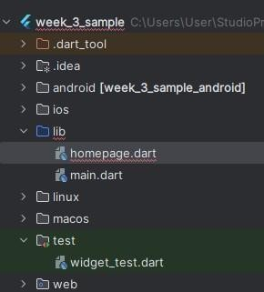
Hands-On – Restaurant App
Create a new Flutter project.
Create a new Dart file named “homepage” in the Flutter lib folder.
Mobile Application System Design

Slide 12
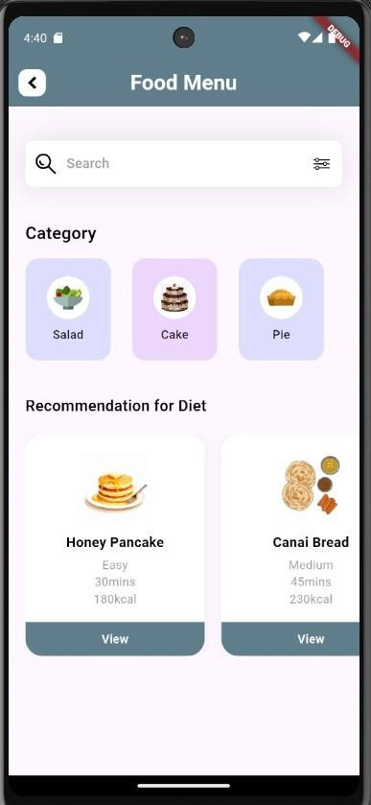
Hands-On – Restaurant App
Today, we will build a home screen for a restaurant app.
You will learn how to create the following widgets:
Text and TextFields
Image and Icon
ListView
You will also learn in more detailed the way to set the alignment, dimension and color for your widgets.
Mobile Application System Design

Slide 13
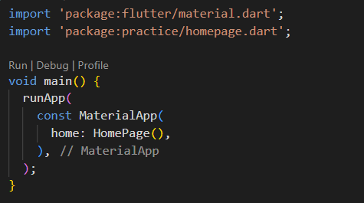
Hands-On – Restaurant App
STEP 1: Create a New Flutter Project
lib/
├── mainrestaurant.dart
├── homepage.dart
└── models/
├── category.dart
└── diet.dart
mainrestaurant.dart will be our starting point (where main() is).
homepage.dart will be the main screen design.
models/ folder will store the data models (Category and Diet info).
Import all assets to your project (images / icons)
Update assets for pubspec.yaml
Mobile Application System Design

Slide 14
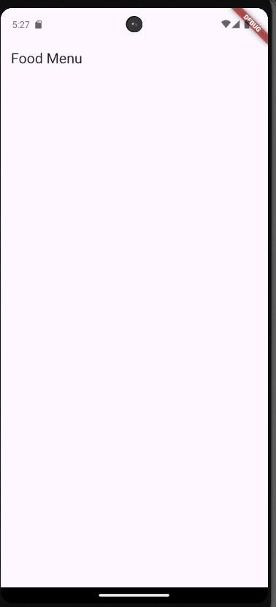

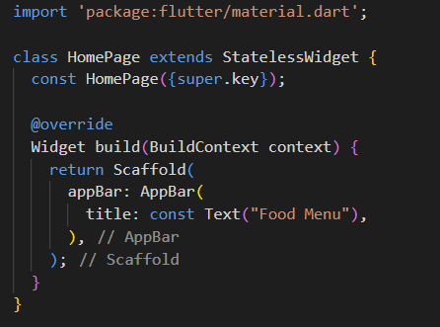
Hands-On – Restaurant App
STEP 2 : In homepage.dart, just type this for now:
Open homepage.dart.
Creates a screen (Scaffold) with an AppBar showing "Food Menu" title.
No body yet.
Mobile Application System Design

Slide 15
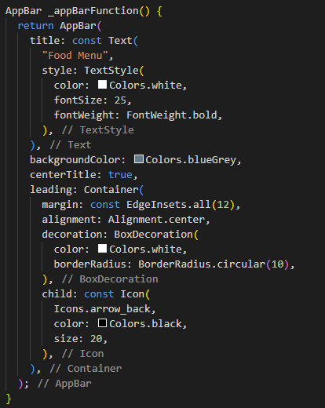
Hands-On – Restaurant App
STEP 3 : Build the AppBar and Search Bar (Basic UI)
In homepage.dart.
First, instead of a plain AppBar, we create a custom function for AppBar
to make it clean and reusable.
Then, in your Scaffold, change:
appBar: _appBarFunction(),
Mobile Application System Design

Slide 16
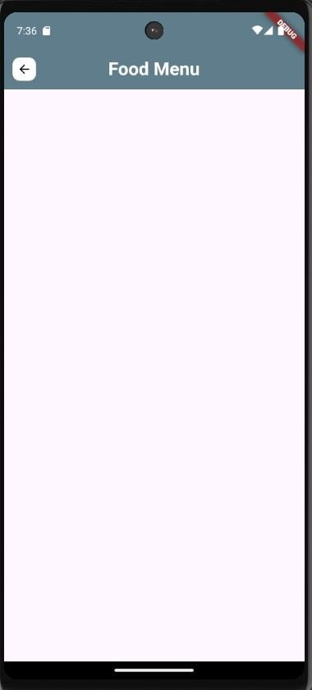

Slide 17
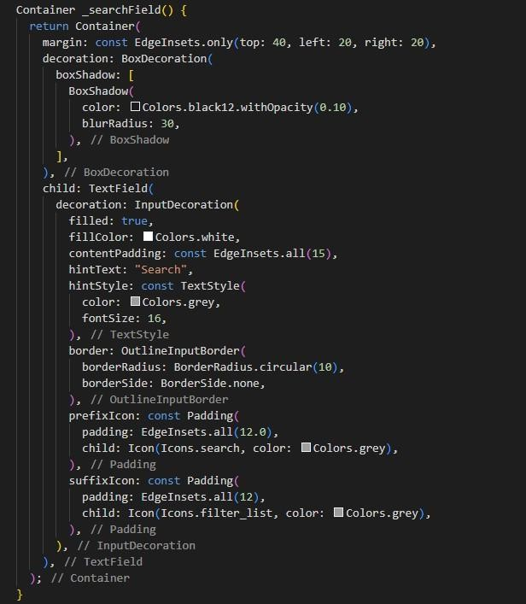

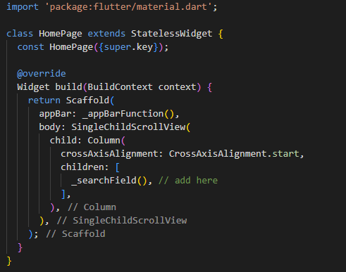
STEP 4 : Add a Search Bar Below the AppBar
In homepage.dart.
Next, add a search bar to let users "search" menu items (even though not
functional yet, it's for design).
Below your _appBarFunction(), create another function
Then inside build(), update your body
Mobile Application System Design

Slide 18
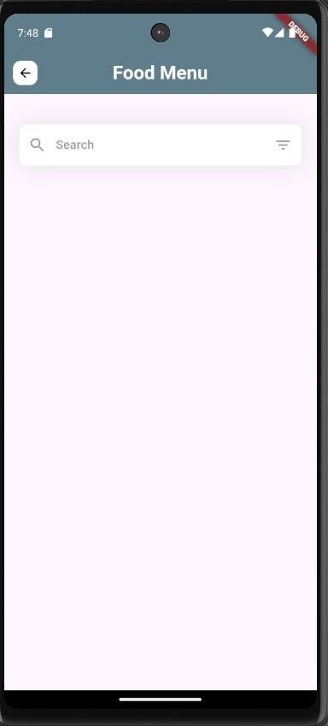

Slide 19
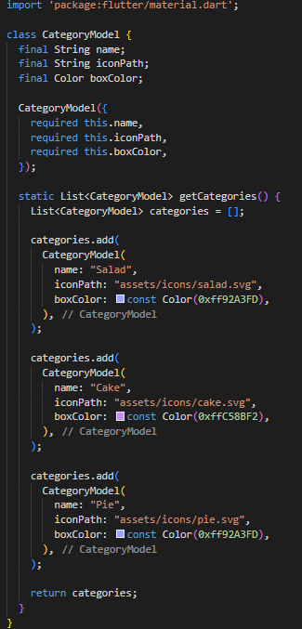
STEP 4 : Create the CategoryModel Class
In lib/models/, open category.dart file.
Copy from category.txt and paste it there

Slide 20
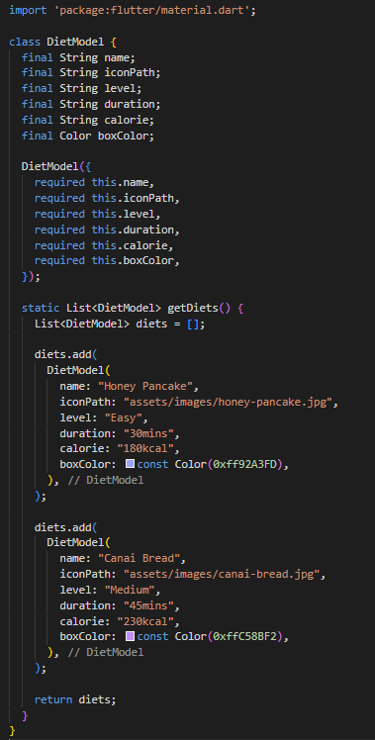

STEP 5 : Create the DietModel Class
In lib/models/, open diet.dart file
Copy from diet.txt and paste it there

Slide 21
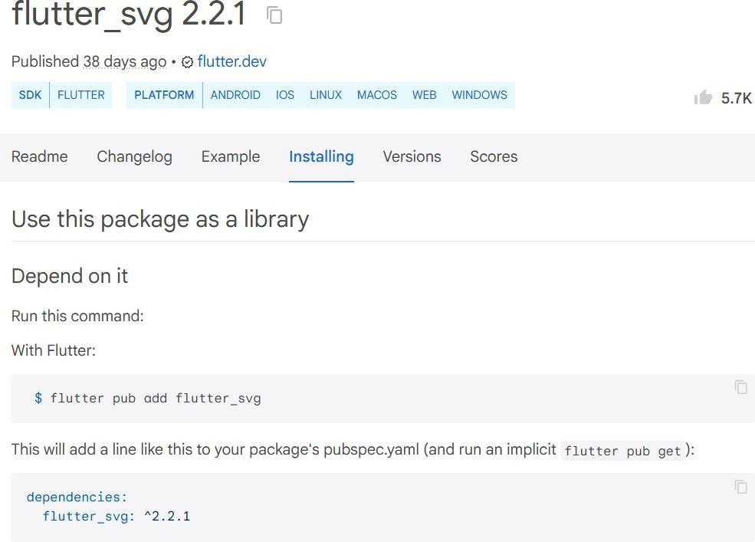
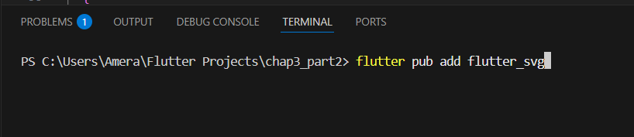
Hands-On – Restaurant App
Search flutter svg (using browser)
Mobile Application System Design

Slide 22
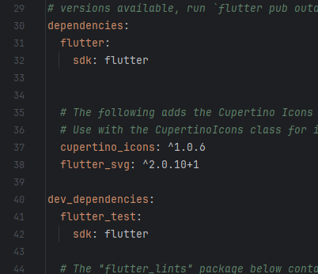
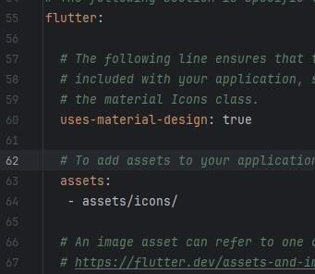

Hands-On – Restaurant App
Open the pubspec.yaml file, and add a new dependency, flutter_svg
In the same yaml file, add the location path for your icons.
Click the “Pub get” on the top to update your project dependencies.
Click
Mobile Application System Design

Slide 23
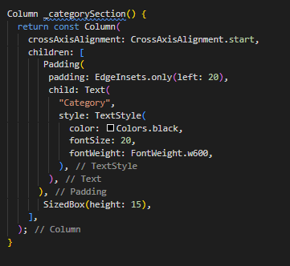

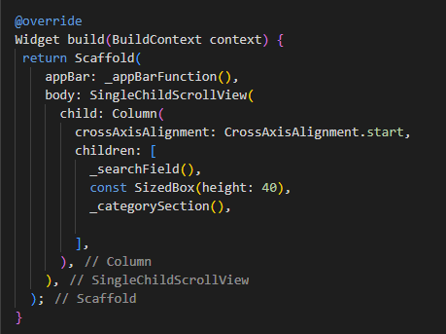
STEP 6 : Create _categorySection()
In homepage.dart, inside the HomePage class, type:
Copy from categoryList.txt to below SizedBox

Slide 24
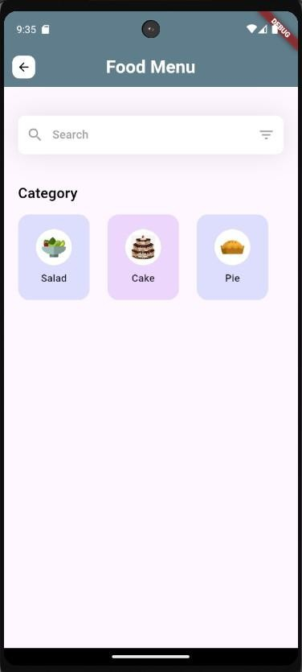

Slide 25
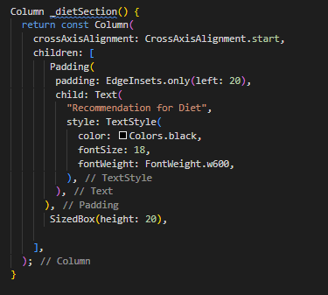

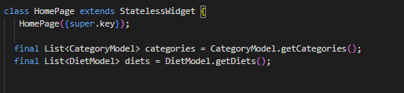
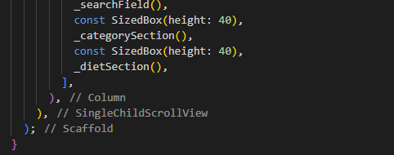
STEP 7 : Create _dietSection()
In homepage.dart, inside the HomePage class, type:
Copy from dietSection.txt to below SizedBox

Slide 26
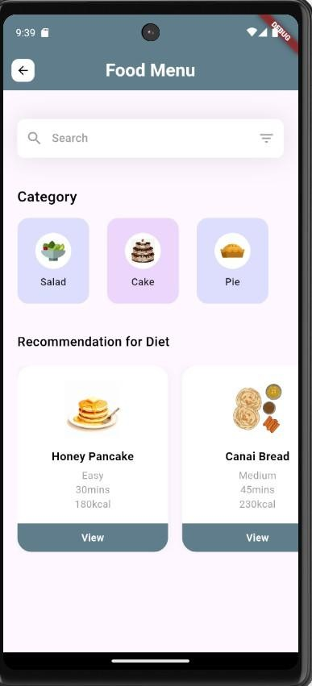

Slide 27
See you next class

